Slide 1
Cross-Site Scripting Attack (XSS)

Slide 2
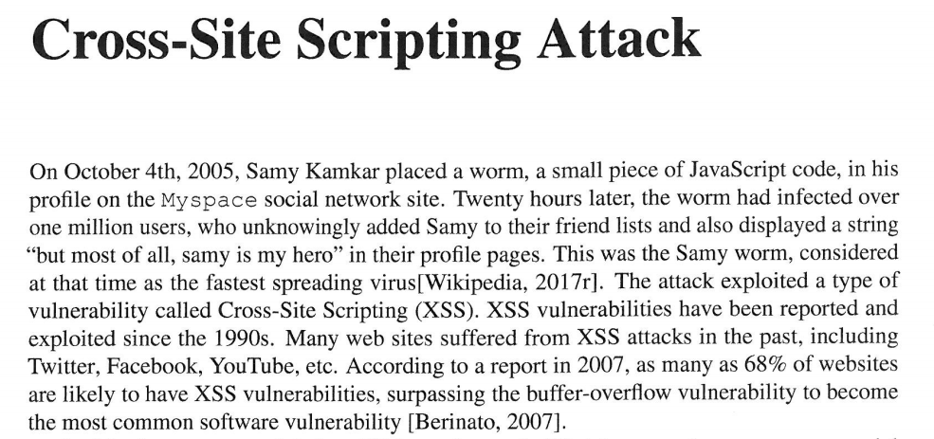

Slide 3
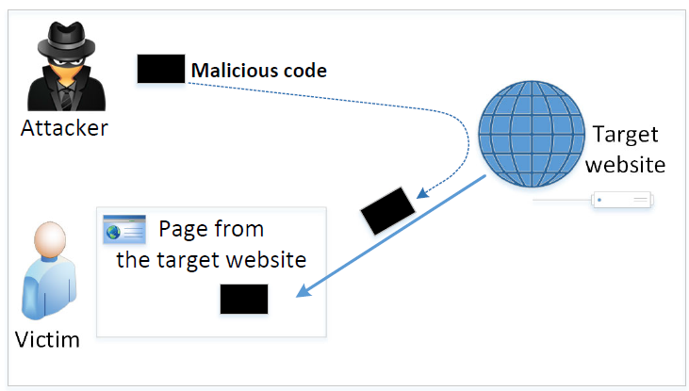
The Cross-Site Scripting Attack
In XSS, an attacker injects his/her malicious code to the victim’s browser via the target website.
When code comes from a website, it is considered as trusted with respect to the website, so it can access and change the content on the pages, read cookies belonging to the website and sending out requests on behalf of the user.
Basically, code can do whatever the user can do inside the session.

Slide 4
Types of XSS Attacks
Non-persistent (Reflected) XSS Attack
Persistent (Stored) XSS Attack

Slide 5
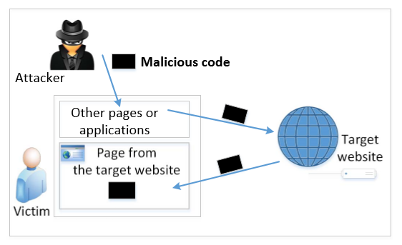
Non-persistent (Reflected) XSS Attack
If a website with a reflective behavior takes user inputs, then :
Attackers can put JavaScript code in the input, so when the input is reflected back, the JavaScript code will be injected into the web page from the website.
Notes:
Many websites take input from the user,conduct some activities and then send response to the user in a web page, with the original user input included on the response (i.e the user input is reflected back)

Slide 6
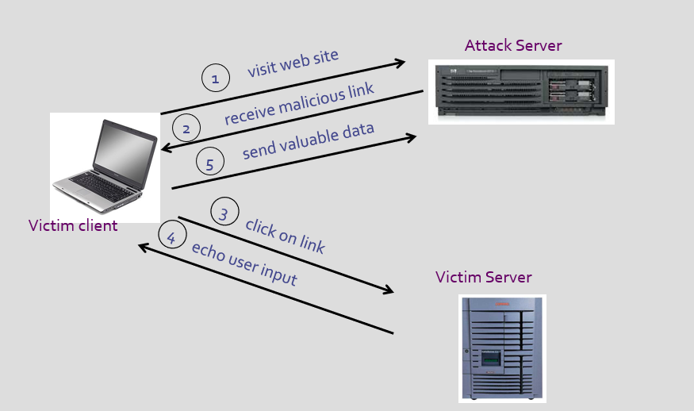

Slide 7
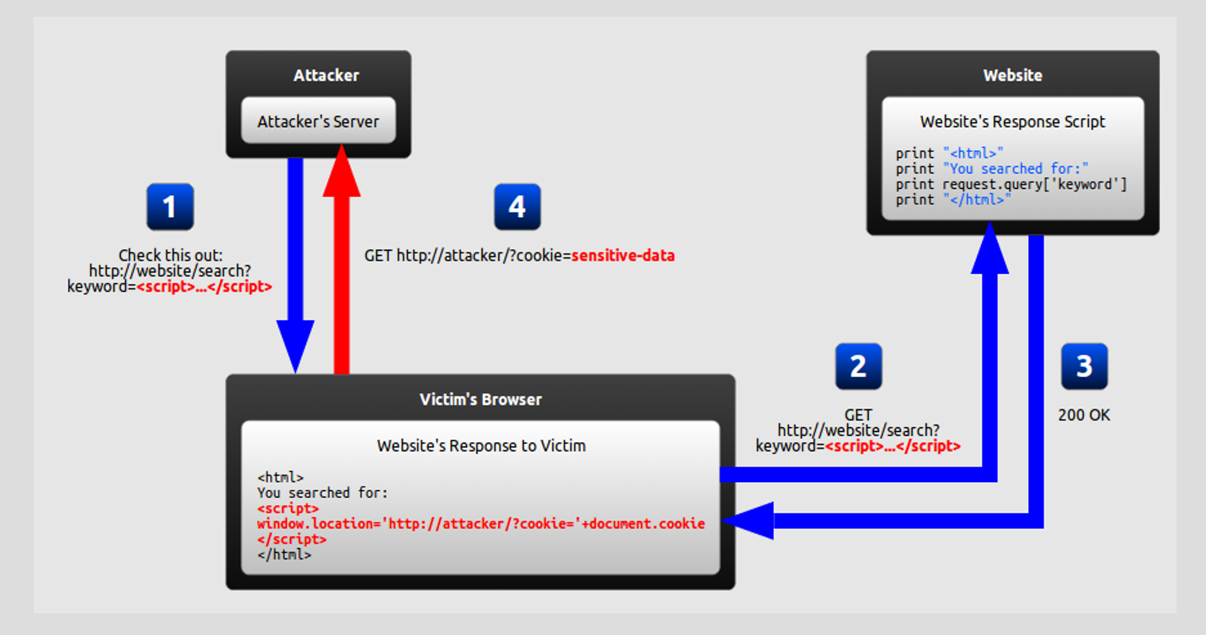

Slide 8
Non-persistent (Reflected) XSS Attack
Assume a vulnerable service on website : http://www.example.com/search?input=word, where word is provided by the users.
Now the attacker sends the following URL to the victim and tricks him to click the link: http://www.example.com/search?input=<script>alert(“attack”);</script>
Once the victim clicks on this link, an HTTP GET request will be sent to the www.example.com web server, which returns a page containing the search result, with the original input in the page. The input here is a JavaScript code which runs and gives a pop-up message on the victim’s browser.

Slide 9
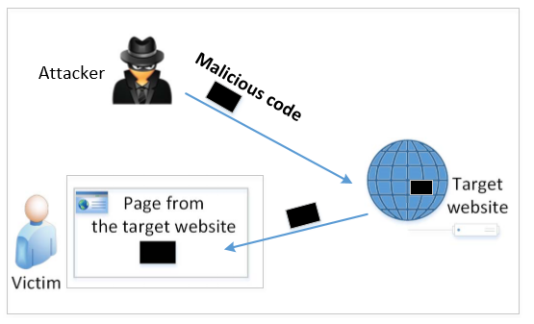
Persistent (Stored) XSS Attack
Attackers directly send their data to a target website/server which stores the data in a persistent storage.
If the website later sends the stored data to other users, it creates a channel between the users and the attackers.
Example : User profile in a social network is a channel as it is set by one user and viewed by another.

Slide 10
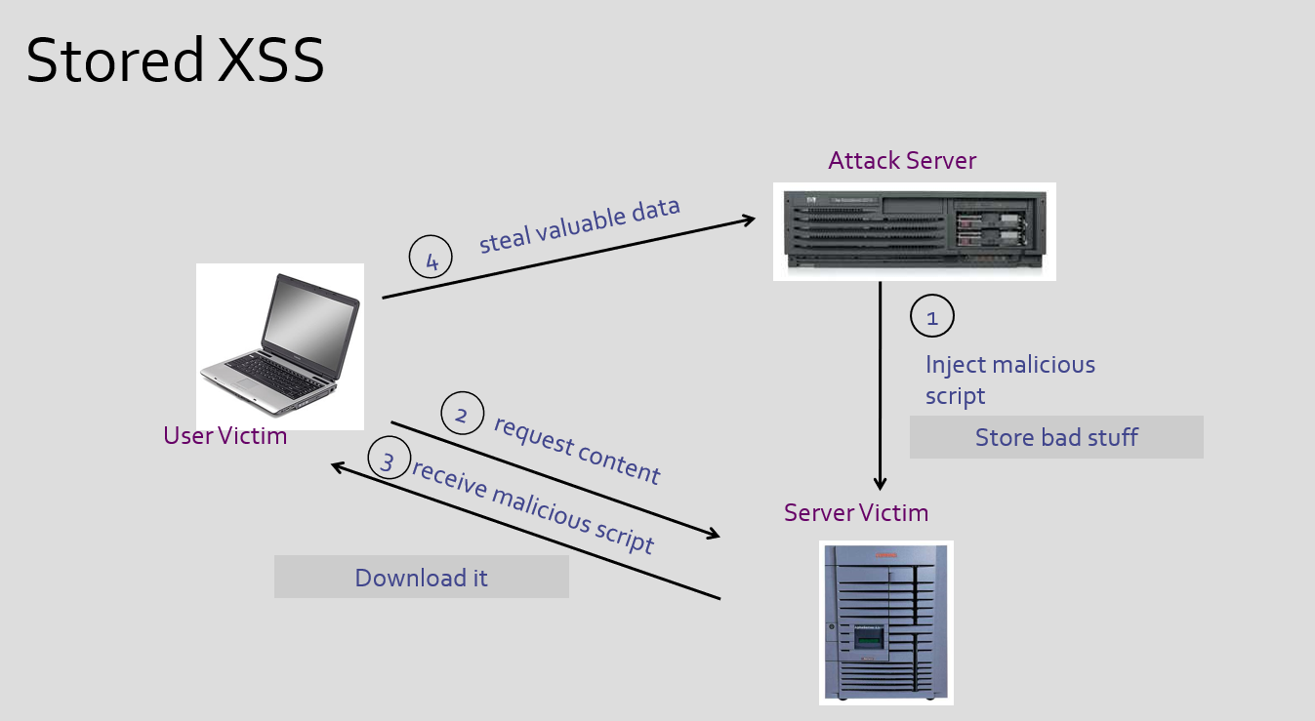

Slide 11
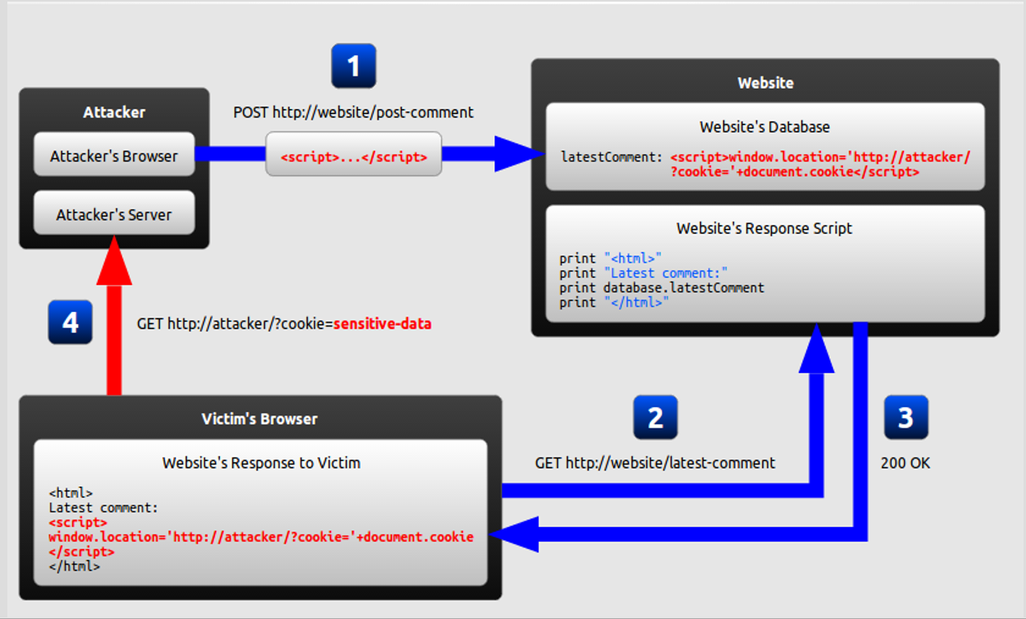

Slide 12
Persistent (Stored) XSS Attack
These channels are supposed to be data channels.
But data provided by users can contain HTML markups and JavaScript code.
If the input is not sanitized properly by the website, it is sent to other users’ browsers through the channel and gets executed by the browsers.
Browsers consider it like any other code coming from the website. Therefore, the code is given the same privileges as that from the website.

Slide 13
Damage Caused by XSS
Spoofing requests: The injected JavaScript code can send HTTP requests to the server on behalf of the user. (Discussed in later slides)
Stealing information: The injected JavaScript code can also steal victim’s private data including the session cookies, personal data displayed on the web page, data stored locally by the web application.

Slide 14
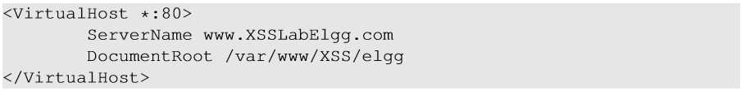
Environment Setup
Elgg: open-source web application for social networking with disabled countermeasures for XSS.
Elgg website : http://www.xsslabelgg.com
The website is hosted on localhost via Apache’s Virtual Hosting

Slide 15
Attack Surfaces for XSS attack
To launch an attack, we need to find places where we can inject JavaScript code.
These input fields are potential attack surfaces wherein attackers can put JavaScript code.
If the web application doesn’t remove the code, the code can be triggered on the browser and cause damage.
In our task, we will insert our code in the “Brief Description” field, so that when Alice views Samy’s profile, the code gets executed with a simple message.

Slide 16
XSS Attacks to Befriend with Others
Goal: Add Samy to other people’s friend list without their consent.
Investigation taken by attacker Samy:
Samy clicks “add-friend” button from Charlie’s account (discussed in CSRF) to add himself to Charlie’s friend list.
Using Firefox’s LiveHTTPHeader extension, he captures the add-friend request.

Slide 17
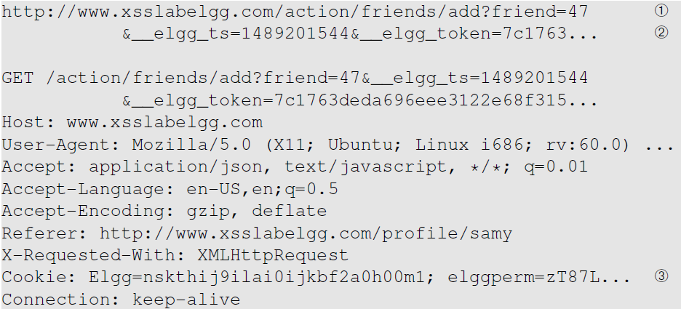
XSS Attacks to Befriend with Others
Line ①: URL of Elgg’s add-friend request. UserID of the user to be added to the friend list is used. Here, Samy’s UserID (GUID) is 47.
Line ②: Elgg’s countermeasure against CSRF attacks (this is now enabled).
Line ③: Session cookie which is unique for each user. It is automatically sent by browsers. Here, if the attacker wants to access the cookies, it will be allowed as the JavaScript code is from Elgg website and not a third-party page like in CSRF.

Slide 18
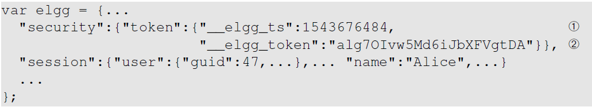
XSS Attacks to Befriend with Others
The main challenge is to find the values of CSRF countermeasures parameters : _elgg_ts and _elgg_token.
Line ① and ②: The secret values are assigned to two JavaScript variables, which make our attack easier as we can load the values from these variables.
Our JavaScript code is injected inside the page, so it can access the JavaScript variables inside the page.

Slide 19
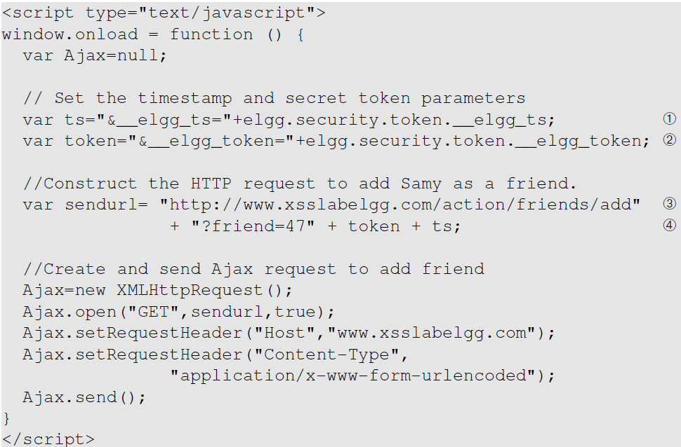
Construct an Add-friend Request
Line ① and ②: Get timestamp and secret token from the JavaScript variables.
Line ③ and ④: Construct the URL with the data attached.
The rest of the code is to create a GET request using Ajax.

Slide 20
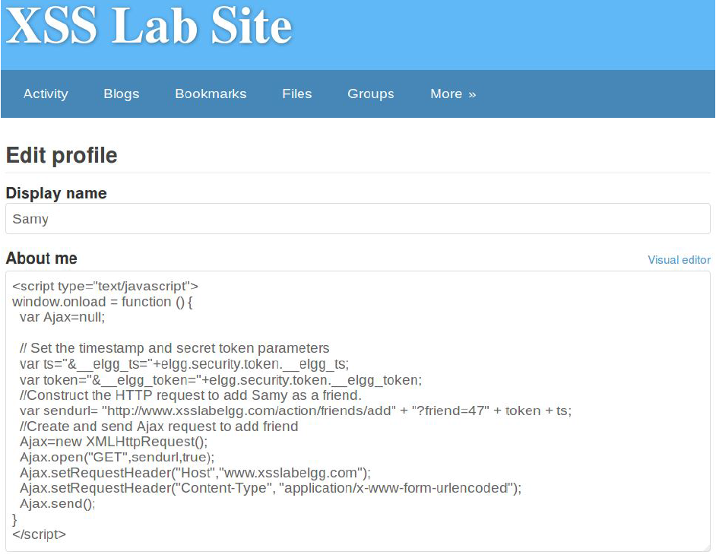
Inject the Code Into a Profile
Samy puts the script in the “About Me” section of his profile.
After that, let’s login as “Alice” and visit Samy’s profile.
JavaScript code will be run and not displayed to Alice.
The code sends an add-friend request to the server.
If we check Alice’s friends list, Samy is added.

Slide 21
XSS Attacks to Change Other People’s Profiles
Goal: Putting a statement “SAMY is MY HERO” in other people’s profile without their consent.
Investigation taken by attacker Samy :
Samy captured an edit-profile request using LiveHTTPHeader.

Slide 22
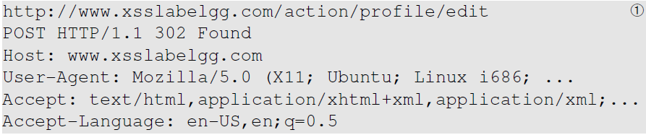
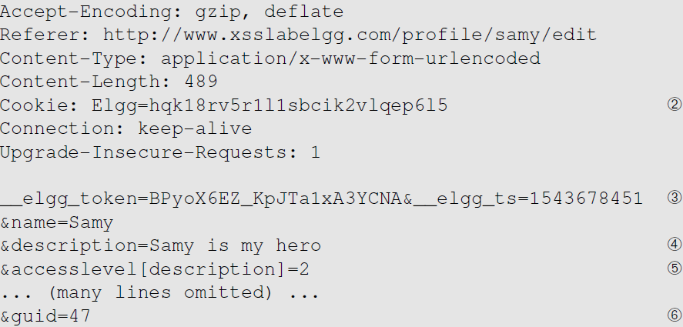
Captured HTTP Request
Line ①: URL of the edit-profile service.
Line ②: Session cookie (unique for each user). It is automatically set by browsers.
Line ③: CSRF countermeasures, which are now enabled.

Slide 23
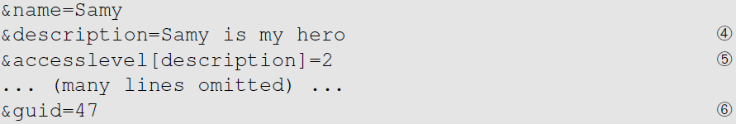
Captured HTTP Request (continued)
Line ④: Description field with our text “Samy is my hero”
Line ⑤: Access level of each field: 2 means the field is viewable to everyone.
Line ⑥: User ID (GUID) of the victim. This can be obtained by visiting victim’s profile page source. In XSS, as this value can be obtained from the page. As we don’t want to limit our attack to one victim, we can just add the GUID from JavaScript variable called elgg.session.user.guid.
Notes:
If the CSRF has already been covered, this is a good time to ask whether we can get the User ID in CSRF? Without knowing the ID, attackers need to know the ID beforehand. In XSS attacks, attackers do not need to do that, they can get the ID directly from inside the page.

Slide 24
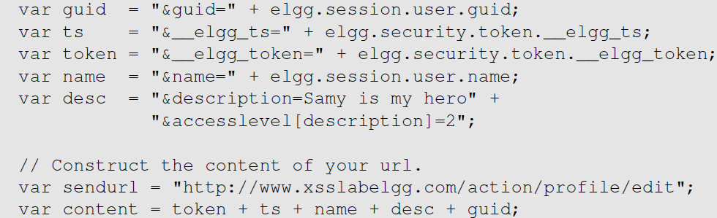
Construct the Malicious Ajax Request

Slide 25
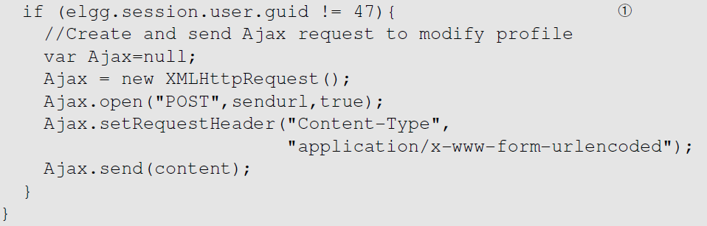
Construct the Malicious Ajax Request
To ensure that it does not modify Samy’s own profile or it will overwrite the malicious content in Samy’s profile.

Slide 26
Inject the into Attacker’s Profile
Samy can place the malicious code into his profile and then wait for others to visit his profile page.
Login to Alice’s account and view Samy’s profile. As soon as Samy’s profile is loaded, malicious code will get executed.
On checking Alice profile, we can see that “SAMY IS MY HERO” is added to the “About me” field of her profile.

Slide 27
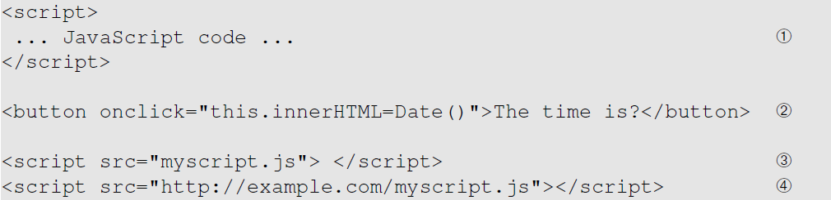
Defeating XSS using Content Security Policy
Fundamental Problem: mixing data and code (code is inlined)
Solution: Force data and code to be separated: (1) Don’t allow the inline approach. (2) Only allow the link approach.

Slide 28
CSP Example
Policy based on the origin of the code
Code from self, example.com, and google will be allowed.

Slide 29
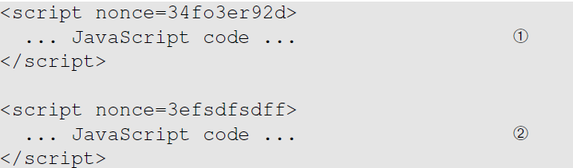
How to Securely Allow Inlined Code
Using nonce
Using hash of the code
Allowed
Not allowed

Slide 30
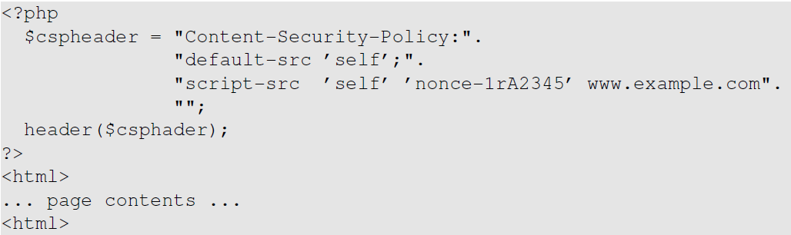
Setting CSP Rules

Slide 31
Discussion Questions
Question 1: What are the main differences of CSRF and XSS attacks? They both have “cross site” in their names.
Question 2: Can we use the countermeasures against CSRF attacks to defend against XSS attacks, including the secret token and same-site cookie approaches?

Slide 32
Summary
Two types of XSS attacks
How to launch XSS attacks
Create a self-propagating XSS worm
Countermeasures against XSS attacks

